Slide 1

Quantitative Data Collection
PT5053
Lucy Metcalfe
Senior Lecturer
l.metcalfe1@londonmet.ac.uk

Slide 2
Learning Objectives
By the end of this session, students will be able to:
Explain key concepts related to outcome measures in physiotherapy
Evaluate the reliability, validity and responsiveness of outcome measures
Identify sources of measurement error and bias in quantitative data collection
Identify ethical considerations in quantitative data collection

Slide 3
Outcome Measures
Most RCTs preselect a single primary outcome measure
Followed by one or more secondary outcomes
This is to evaluate treatment efficacy.
Statistically significant = P < 0.05
An outcome (or end point) is a direct or indirect measurement of the effect of an intervention on a participant's clinical function or status
Ideally the results of an RCT should be generalised to the whole population

Slide 4
Patient Reported Outcome Measures (PROM)
PROM are assessments made directly by the patients themselves rather than observers
This includes symptoms of severity, of functional health status, health related quality of life
Most PROMs are recorded in self completed questionnaires with validated scales, that are standardised and scored

Slide 5
Patient Reported Outcome Measures (PROM)
PROM include collecting information on symptoms, health-related quality of life and functional status.
Symptoms: (pain) – Visual Analog Scale (VAS)
Functional status: The Roland-Morris Disability Questionnaire, Barthel Index
HRQoL: SF-36
Health behaviour: The International Physical Activity Questionnaire (IPAQ)
(Quel De Oliveira et al.)

Slide 6
Primary Outcome Measures
Primary outcome measures: represent the main reason the trial is being conducted
Normally an RCT has only ONE primary outcome measure

Slide 7
Secondary Outcome Measures
RCT often have additional important outcomes
These outcomes may not be statically conclusive
They can be useful to generate further hypotheses and guide future trials and studies
Because of their importance in justifying future studies, these additional outcomes need careful consideration

Slide 8
Bias in outcome measures
Need to look for: outcome reporting bias
This is a particular issue for PROM where multiple health domains are measured within a single questionnaire and not always fully reported on
(Macefield et al.)

Slide 9
Bias in outcome measures
Performance Bias: difference in the way patients in two treatment arms are managed post intervention
Ascertainment Bias: collectively observed bias
Reporting Bias: how the data is reported by assessors
Both performance and observation bias can occur on a conscious or subconscious level and may arise from preexisting expectations about the efficacy of the treatment, knowledge or treatment allocation
(Macefield et al.)

Slide 10
Reducing Bias in Outcome Measures
One method that can be used to minimise the risk is blinding.
Hide treatment allocation from the research team or trial participants
(Macefield et al.)

Slide 11
Thoughts when critically appraising?
Do these outcome measures match the population of this research?
Can these outcome measures be replicated?
Do they report on all the findings?
Do the outcome measures link to the condition / intervention?

Slide 12
Psychometric Foundations
To determine confidence in clinical tools
Validity: measure what they intent to measure
Reliability: stable over time
Responsiveness: can detect change in conditions

Slide 13
Validity
The tools' ability to measure what it is supposed to measure
Is the tool measuring the construct it is intent to?
Implies that the tool is relatively free from error?
If research has high validity, that means it produces results that correspond to real properties, and variations

Slide 14
Types of Validity
Content Validity: Establishes that the multiple items that make up a questionnaire, inventory, or scale adequately sample the universe of content that defines the construct being measured.
Construct Validity: Establishes the ability of an instrument to measure the dimensions and theoretical foundation of an abstract construct

Slide 15
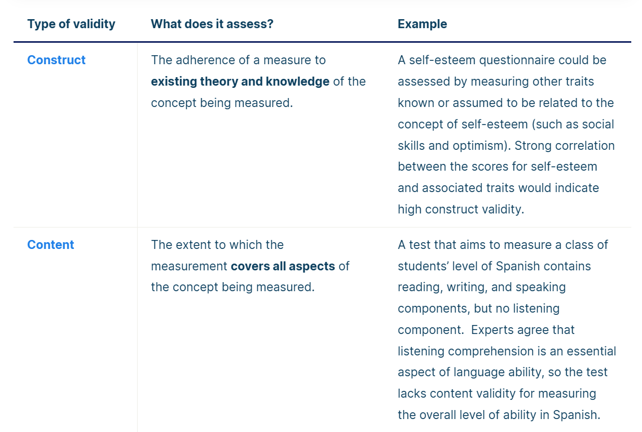

Slide 16
Reliability
Refers to the extend to which a measurement is consistent and free from error → how consistently a method measures something
Test-retest reliability: the stability of scores obtained by a patient when they are evaluated on two separate occasions
Intra-rater: the same evaluator over time (same tester over two separate occasions)
Inter-rater: Different evaluators usually within the same time period

Slide 17
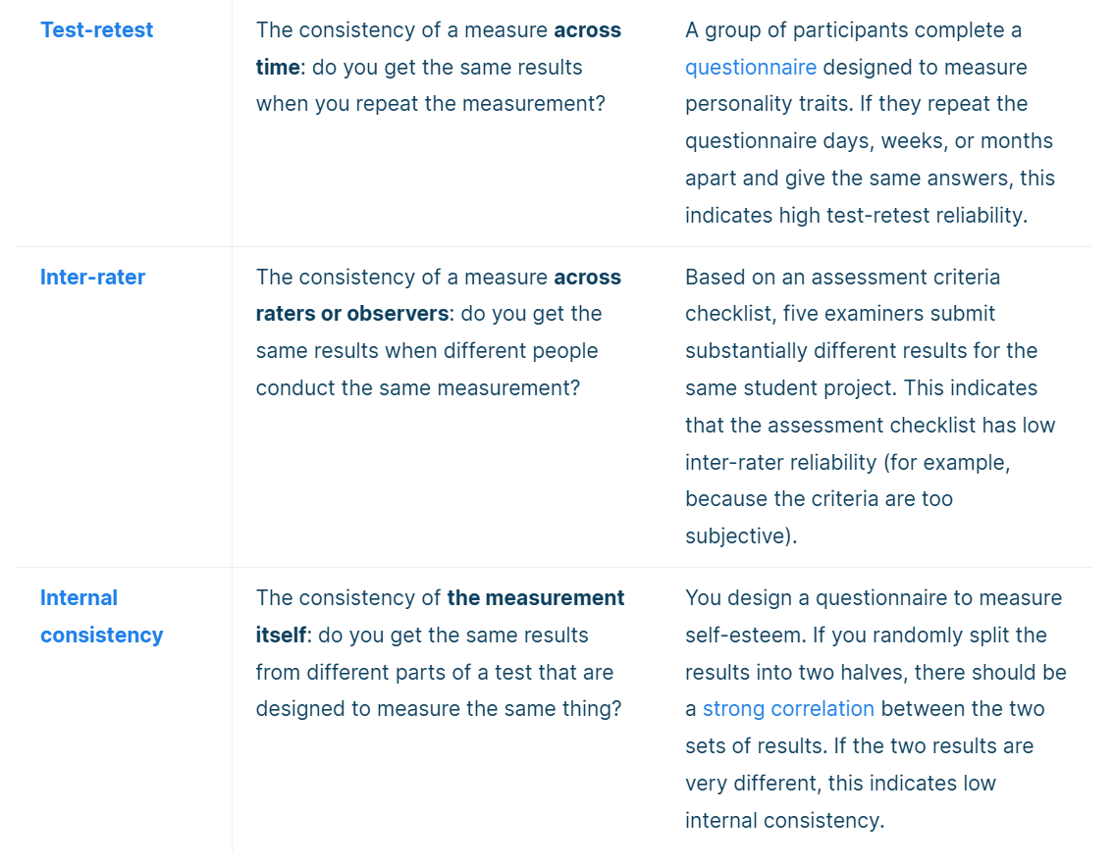

Slide 18
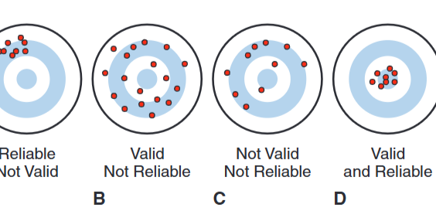
(Portney)

Slide 19
Responsiveness
Sensitivity to change
The ability of an instrument to measure small changes that are clinically important
Where participants or patients respond to effective therapeutic interventions
The responsiveness of a measuring instrument is its ability to detect change over time
(Portney)

Slide 20
Minimal Detectable Difference / Change
MDD / MDC
The minimum amount of measured change needed before we can rule out measurement error as being solely responsible
Minimal Clinically Important Difference MCID: is the smallest difference in a measured variable that signifies an important difference in the patient’s condition
The MCID is a reflection of the test’s validity and can be helpful when choosing an instrument, setting goals for treatment, and determining whether treatment is successful.
(Portney)

Slide 21
Ethical Considerations in Research
Researchers must inform the potential participants when a study is planned that includes a control group (RCT)
When the study involves randomisation, subjects should know that there is a chance they could be assigned into either control or intervention
Confidentiality of all information should be maintained
Subjects must be free to withdraw consent at any time
(Portney)

Slide 22
Ethical Considerations in Research
Is the study truly representing the patient group / representation
Informed consent: The informed consent process begins with an invitation to participate. A statement of the purpose of the study permits potential subjects to decide whether they believe in or agree with the worth and importance of the re-search.
(Portney)

Slide 23
Ethical Considerations in Research
An important aspect of informed consent is the description of all reasonably foreseeable risks or discomforts to which the patient will be subjected, directly or indirectly, as part of the study. The researcher should detail the steps that will be taken to protect against these risks and the treatments that are available for potential side effects
(Portney)

Slide 24
Research Misconduct
Fabrication: making up data or results or recording them wrong
Falsification: manipulating research materials, equipment or processes or results so that the data is not accurately represented
Plagiarism: appropriation of another person’s idea, process, results or words without giving credit or representation
(Portney)

Slide 25
Common outcome measures used:

Slide 26
Visual Analogue Scale
The pain VAS is a unidimensional measure of pain intensity, used to record patients’ pain progression, or compare pain severity between patients with similar conditions
A mean reduction in VAS of 3 points represents a clinically meaningful importance in pain severity.

Slide 27
The Roland-Morris Disability Questionnaire
The Roland-Morris Disability Questionnaire is most sensitive for patients with mild to moderate disability due to acute, sub-acute, or chronic low back pain

Slide 28
SF-36
An outcome measure that is often used, well-researched, self-reported measure of health.
It comprises 36 questions that cover eight domains of health
1) Limitations in physical activities because of health problems.
2) Limitations in social activities because of physical or emotional problems
3) Limitations in usual role activities because of physical health problems
4) Bodily pain
5) General mental health (psychological distress and well-being)
6) Limitations in usual role activities because of emotional problems
7) Vitality (energy and fatigue)
8) General health perceptions
The SF-36 is often used as a measure of a person or population’s QoL

Slide 29
Outcome measures psychometric properties
It is important to investigate the psychometric properties of every outcome measure (primary) used
You should consider the validity, reliability, responsiveness, minimal detectable change and minimal clinically important detectable change
Website for patient related outcome measures: https://www.sralab.org/

Slide 30
Website for patient reported outcome measures (PROMS)
https://www.sralab.org/
Lets look at:
Numerical Pain Rating Scale
Roland-Morris Disability Scale
iHOTT-33

Slide 31
Outcome Measures
When critically appraising the outcome measures used in the RCT
Look for MCID or MDC
Reliability
Validity
Responsiveness

Slide 32
Power Calculation
A power calculation is made before the study to calculate the sample size necessary to detect a true difference between outcomes in the CONTROL and INTERVENTION groups
You should ALWAYS see a power calculation reported, usually in the methods section
It is based on the primary outcome measure – only the outcome for which research has been set up to measure
Secondary outcomes are only there for guidance and future research

Slide 33
Power calculation
Power of 80-90% is standard
If authors do not manage to recruit enough people (or do but have a large drop out) then we say the study is UNDER POWERED
This means it is harder to truly say the findings are significant

Slide 34
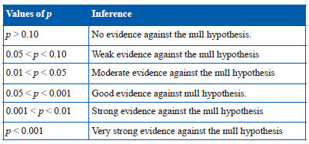
P Value
A p-value is calculated to assess whether results are likely to have occurred simply through chance
P-values simply provide a cut off beyond which we assert that the findings are statistically significant (p<0.05)
0.05 = 5% chance the result is a fluke between groups

Slide 35
Confidence Intervals
A confidence interval are calculated to measure the treatment effect
It shows the range within the true treatment effect is likely to be
Confidence intervals aid interpretation of clinical trial data by putting upper and lower bounds on the likely size of any treatment effect

Slide 36
Journal Trustworthiness
Credibility
Impact Factor
Is this a good journal that publishes research?
Does it focus on publishing high-quality research rather than just increasing the volume of items?

Slide 37
Journal – Impact Factor
Academic journal ranking
Journals with the higher impact factor values are considered more prestigious or important within their field
It is calculated by Clarivates Web of Science
The impact factor of a journal reflects the year mean number of citations published in the last two years

Slide 38
Journal - Credible
A trustworthy journal exhibits transparency, rigorous review process and high-quality editorial standards
Do they publish research similar to what you are reading?
E.g. sports medicine, respiratory, musculoskeletal, physiotherapy, medicine?

Slide 39
Where do you find impact factor?
Go to the journals homepage
Find it via: https://www.sciencedirect.com/
For example:
British Journal Sports Medicine (BJSM) = 16.3
Lancet = 88.5

Slide 40
Limitations
All studies have limitations
Limitations represent weaknesses within the study that may influence outcomes and conclusion of research
The goal of presenting limitations is to provide meaningful information to the reader
It is your decision to critically appraise the limitations or other limitations of the study
Do the authors sufficiently report the limitations of their study

Slide 41
Strengths
What was the strength of the study?
Adequacy blinded?
Did not lose many participants? Low drop out rate
Reported the findings well / concisely for the reader?
Real world transferable?

Slide 42
Critical Appraisal
The success of evidence-based practice will depend on how well we incorporate research findings into our clinical judgments and treatment decisions. We have a responsibility to evaluate research reports to determine whether the findings provide sufficient evidence to support the effectiveness of current practices or offer alternatives that will improve patient care
(Portney)

Slide 43
Critical Appraisal
To be a critical consumer, those who seek evidence must be able to retrieve and read published studies and make judgments about the validity and relevance of the information.
(Portney)

Slide 44
Are the results meaningful?
Are the findings of sufficient strength to inform management of patients?
Were the participants sufficiently similar to my patient to allow generalization of findings?
If the study does provide potentially useful findings, will the patient find the treatment or test acceptable?
Is the treatment or test feasible, given my clinical setting and available resources?
(Portney)

Slide 45
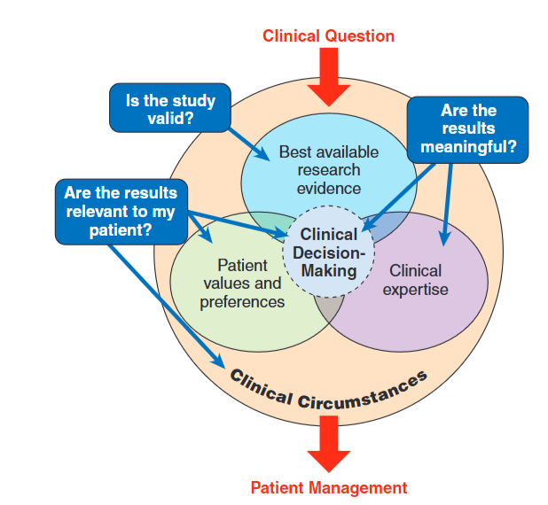
Clinical Reasoning Process

Slide 46
Are the results meaningful?
Authors should be able to discuss how their findings are supported by previous research. Researchers should be able to discuss the clinical context and application of the findings
Results should be considered within the context of the patients to whom they will apply to determine if they will impact patient management decisions.
(Portney)

Slide 47

Questions?

Slide 48
References
Macefield, Rhiannon C., et al. “Selecting and Measuring Optimal Outcomes for Randomised Controlled Trials in Surgery.” Langenbeck’s Archives of Surgery, vol. 399, no. 3, 2014, pp. 263–272, www.ncbi.nlm.nih.gov/pmc/articles/PMC3961630/#__ffn_sectitle, https://doi.org/10.1007/s00423-013-1136-8.
Portney, Leslie G. Foundations of Clinical Research: Applications to Practice. 4th ed., Philadelphia, F.A. Davis Company, 2020.
Quel De Oliveira, Camila, et al. “Use of Patient-Reported Outcome Measures in Physiotherapy Clinical Trials in Six Major Physiotherapy Journals 2 Decades Apart (2000–2018): A Meta-Research Design.” Physical Therapy Reviews, vol. 30, no. 4, 3 July 2025, pp. 318–326, https://doi.org/10.1080/10833196.2025.2524661. Accessed 21 Nov. 2025.

